Slide 1
Advanced PYTHON -
INT

Slide 2
Advanced Collections

Slide 3
Topics for Today:
List Comprehensions
Iterator in python
Lambda expressions
Built in functions – map,filter,reduce
Generator functions
Declarative Programming

Slide 4
List/Dictionary Comprehensions
Sugar syntax substitute replacing for loops / map some of the time.
Notice that the syntax for dictionary/list is alike.
**Example**

Slide 5




Iterator (and Iterable)
What the heck is that?
Let’s begin with examples.
In all those examples, we Iterate through an object of some type (list,string,dictionary,file).

Slide 6
Iterators
An Iterable is an object in python that can be iterated through.
Another definition – An object that returns an Iterator.
Meaning – capable of returning its elements one at a time.
Hence – permitting it to be iterated in a for loop.
Under the hood
Every object that overrides the function __iter__() is Iterable. __iter__() return an Iterator.
An iterator is an object that’s used for iterating over an Iterable.
We need to know only one function of the Iterator – Next()
**Example in pycharm**

Slide 7
Iterators - Exercise
Create a new list of hundred integers and print all the elements inside it. The catch is that you have to use the iterator functions (__iter__ and next) to print them.
What happens when you call the next() function more times than the list length? (Fun~)
You can use the iter keyword (Read about it!)

Slide 8
Iterators – Summing it up
I want to emphasize –
Iterable – An object that can be iterated through, and in python it implements the function ___iter__()
Iterator – An object that iterates on an iterable, (Both can be the same object).
Iterator has the function next() to go through the elements.
When the Iterator gets to the end of the iterable – it throws an Exception.

Slide 9
Things you can do with it
A lot of functions accepts iterable objects:
Sum (Summing the elements values in the object)
List (Creates a list of the objects elements)
Much more!
We’ll see in a second the map, filter and reduce functions
All those functions accepts iterable objects (Try it yourself!)

Slide 10
Another Exercise on Iterator
Please create the rangeI() object, accepting two arguments (start of the range and ending, exactly like Python’s).
The object should implement the __iter__ function, and create in run time the next element for next.
Can be used in a for loop or any other needed place (the same as REAL range function)
If used twice – Getting expected results.

Slide 11
Map, Filter and Reduce
Sugar syntax (Rembember? ☺) for not using loops and if’s
The three function takes a function and an iterable and preforms some operation on it.
Map – Performs the function to all the elements in the iterable.
Filter – Filters all the elements by some function.
Reduce – Performs to all the elements the same function in couples.
***Example in pycharm***

Slide 12
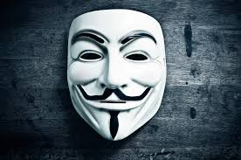
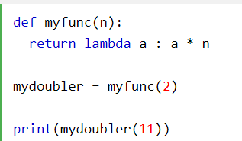
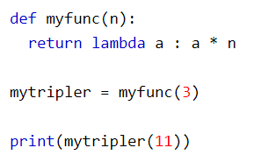

Lambda Expressions
Just a function as all function
Doesn’t have a name (anonymous)
Easy way to create a small function when a named one is not needed
Mostly used with map and filter (in the next slide).
Remember – in python, a variable can hold a function as well.
Examples:

Slide 13
Exercises
Write a function that accepts a list and doubles (power two) all the numbers in the list.
Write a python function that accepts iterable and returns the number of even and odd numbers in the iterable (Using lambda and map\filter)
Write a function that accepts a dictionary and filters out all the values of the dictionary who are not strings’ type.
Create a function that sums an iterable values using reduce.

Slide 14
Generator Functions
Here is how a generator function differs from a normal function.
Generator function contains one or more yield statements.
When called, it returns an object (iterator) but does not start execution immediately.
Methods like __iter__() and __next__() are implemented automatically. So we can iterate through the items using next().
Once the function yields, the function is paused and the control is transferred to the caller.
Local variables and their states are remembered between successive calls.
Finally, when the function terminates, StopIteration is raised automatically on further calls.
** Example **

Slide 15
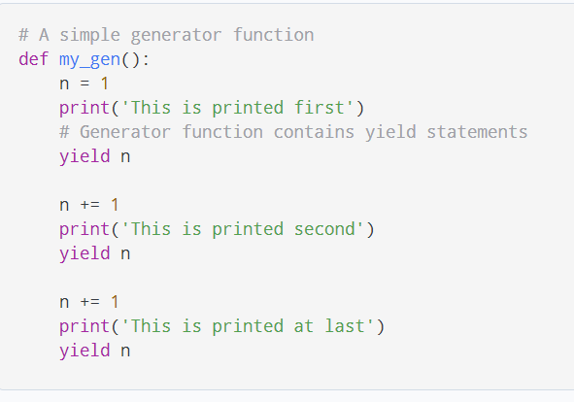
Generator Functions

Slide 16
Declarative Programming
A programming paradigm (style of building software) in which you express you what the program does without the how.
The how is left for the underlying implementation
Examples for declarative programming are SQL, REGEX and more.
In Python Declarative Programming is mostly used with TensorFlow and Numpy.

